Slide 1
MY JOURNAL TO PYTHON
Name: 菲利浦 – John Philip R. Almonia Teacher: My Great Teacher

Slide 2
AGENDA
- Python - Input and output - Data types: Booleans and List (Python Lists) - Access List Items - Change List Items - Add List Items - Remove List Items - Loop List - List Comprehension - Sort Lists - Copy Lists - Join Lists - List Methods - Operators ON data type:

Slide 3
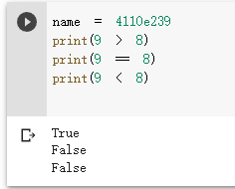
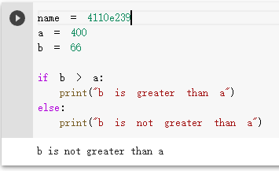
DATA TYPES: Booleans
Boolean Values
- In programming you often need to know if an expression is True or False.
- You can evaluate any expression in Python, and get one of two answers, True or False.
- When you compare two values, the expression is evaluated and Python returns the Boolean answer:
When you run a condition in an if statement, Python returns True or False:

Slide 4
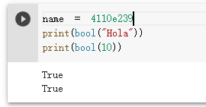
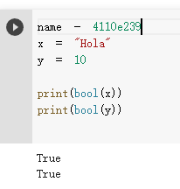
Evaluate Values and Variables
- The bool() function allows you to evaluate any value, and give you True or False in return,
Example Evaluate a string and a number:
Example
Evaluate two variables:

Slide 5
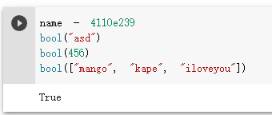
Most Values are True
- Almost any value is evaluated to True if it has some sort of content.
- Any string is True, except empty strings.
- Any number is True, except 0.
- Any list, tuple, set, and dictionary are True, except empty ones.
Example
The following will return True:

Slide 6
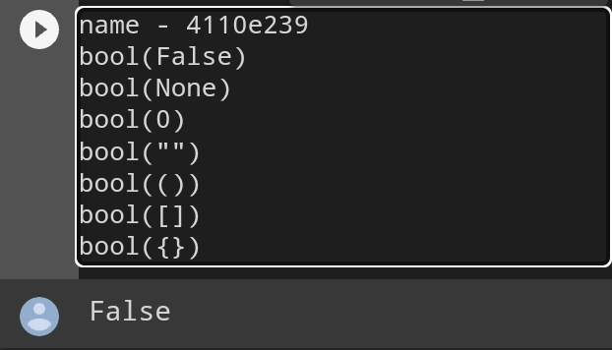
Some Values are False
- In fact, there are not many values that evaluate to False, except empty values, such as (), [], {}, "", the number 0, and the value None. And of course the value False evaluates to False.
Example
The following will return False:

Slide 7
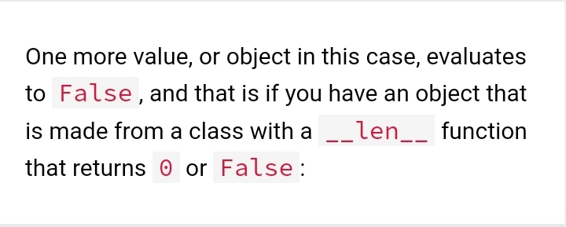
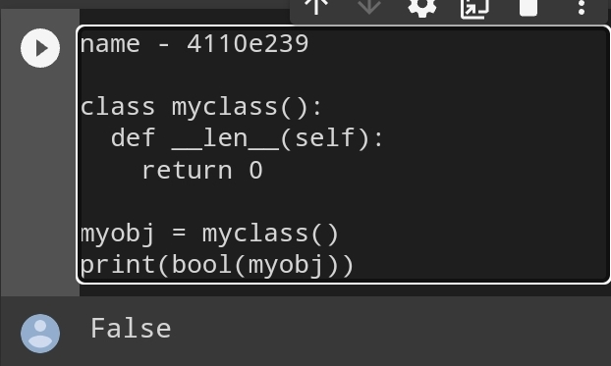

Slide 8
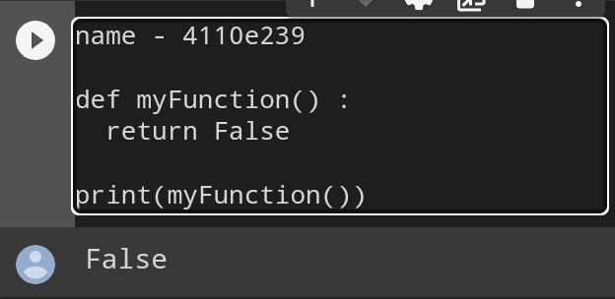
Functions can Return a Boolean:
You can create functions that returns a Boolean Value:

Slide 9
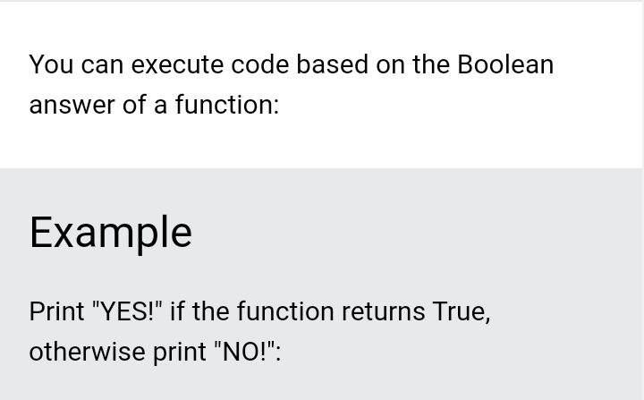
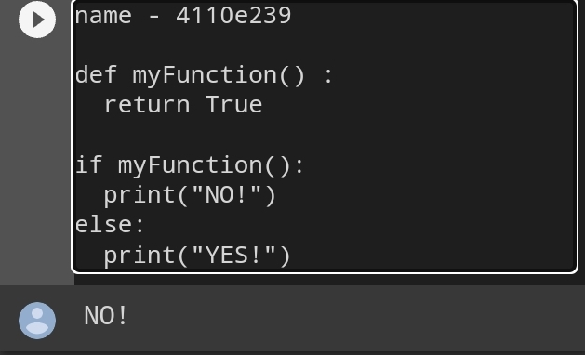

Slide 10
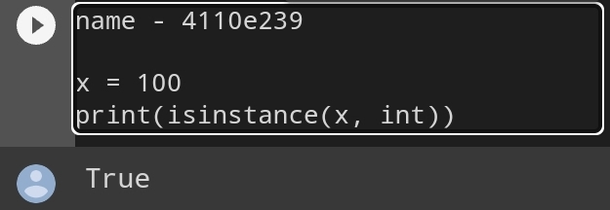
Python also has many built-in functions that return a boolean value, like the isinstance() function, which can be used to determine if an object is of a certain data type:

Slide 11
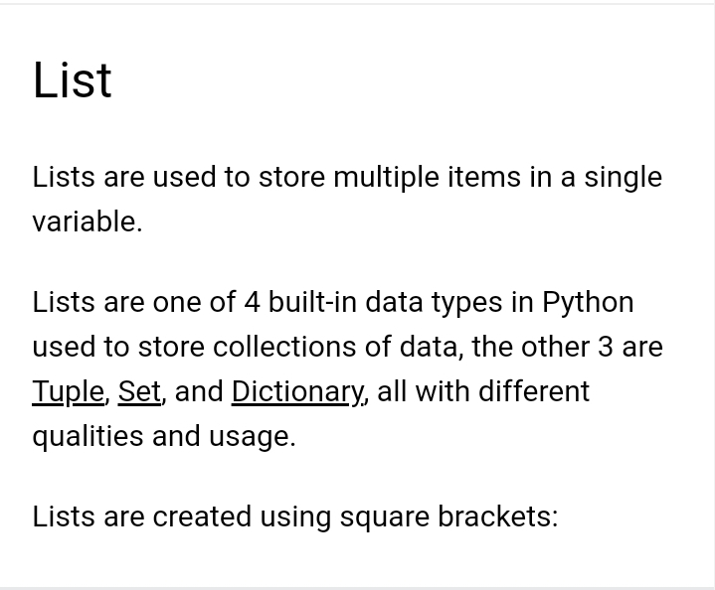
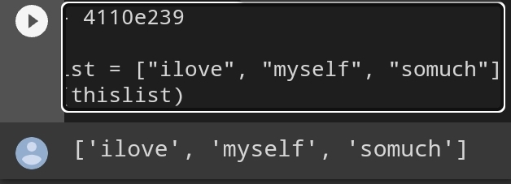
Python List

Slide 12
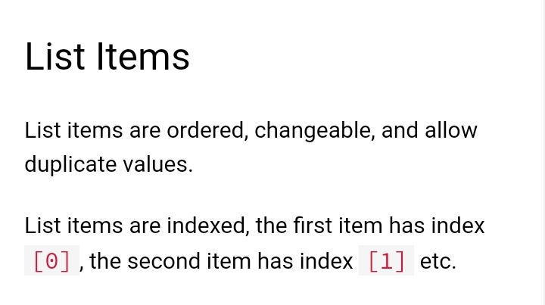

Slide 13
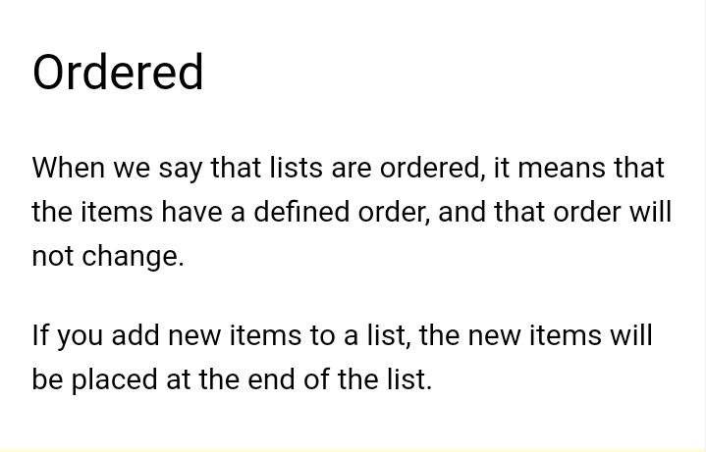

Slide 14
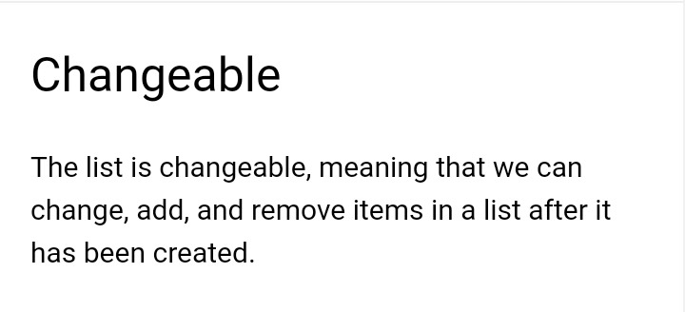

Slide 15
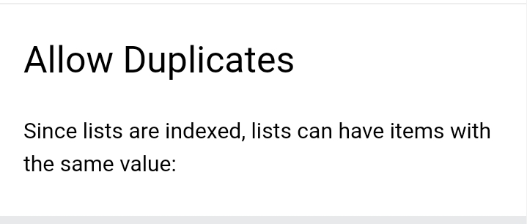
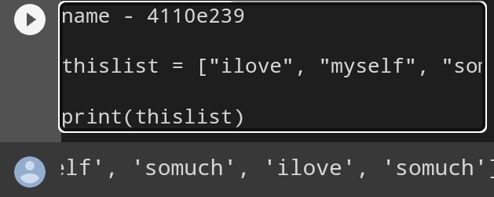

Slide 16
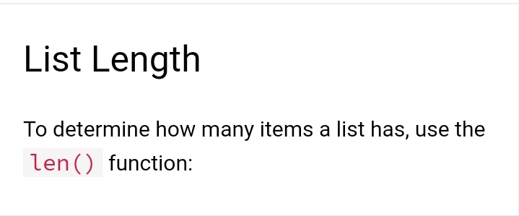
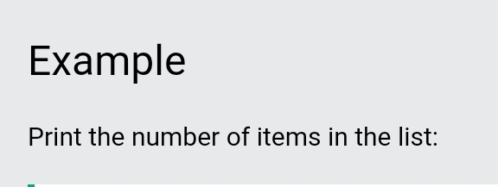
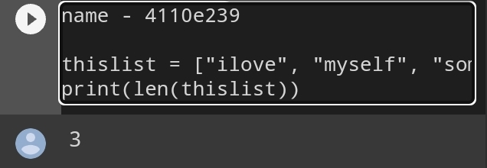

Slide 17
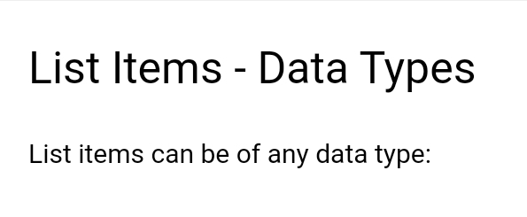
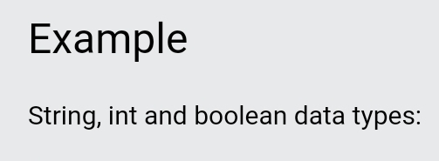
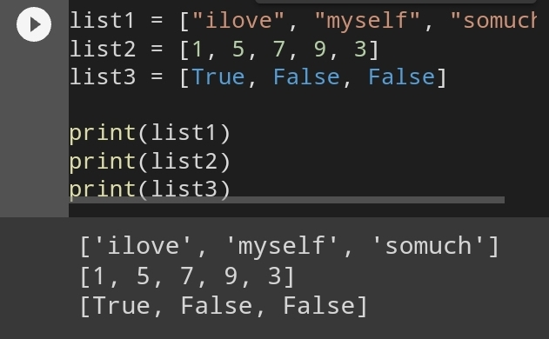

Slide 18
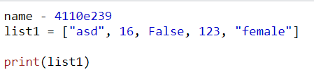
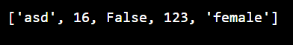
A list can contain different data types:
Example
A list with strings, integers and boolean values:

Slide 19
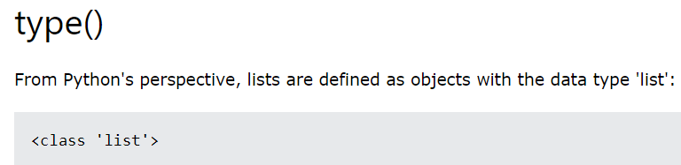
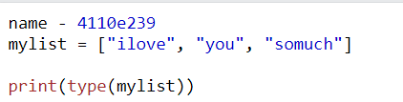
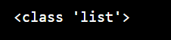
Example
What is the data type of a list?

Slide 20
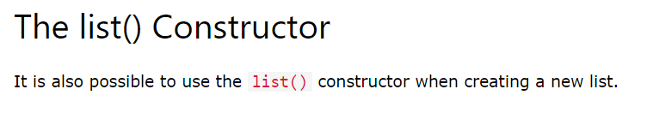
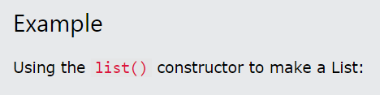
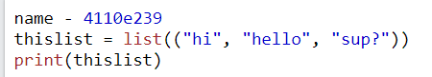
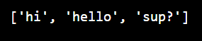

Slide 21
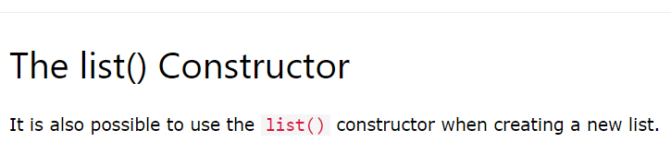
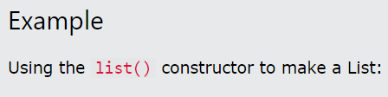
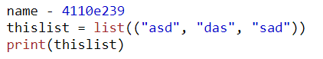
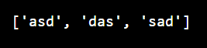

Slide 22
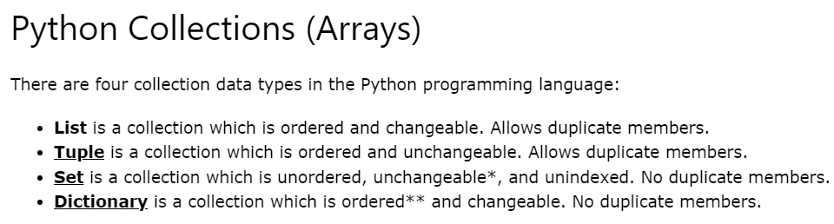

Slide 23
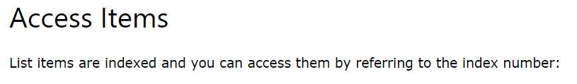
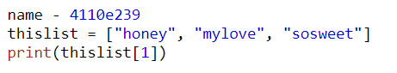
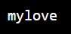
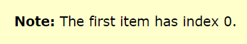
Python - Access List Items
Example
Print the second item of the list:

Slide 24
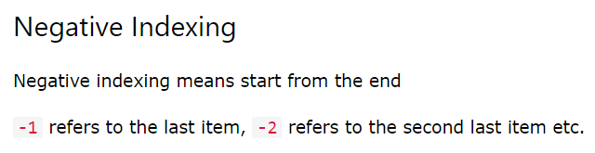
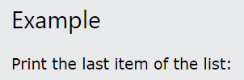
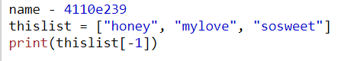
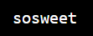

Slide 25
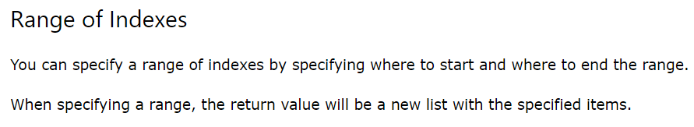
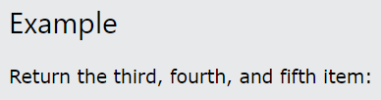
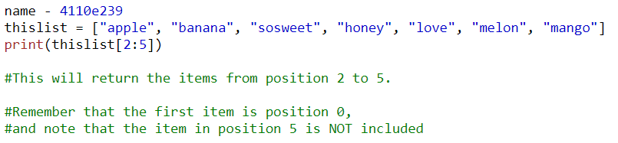


Slide 26



Example
This example returns the items from the beginning to, but NOT including, “love":

Slide 27

By leaving out the end value, the range will go on to the end of the list:
Example
This example returns the items from “honey" to the end:

Slide 28




Slide 29



Example
Check if "apple" is present in the list:

Slide 30



Python - Change List Items
Example
Change the second item:

Slide 31





Slide 32





Slide 33



Note: As a result of the example above, the list will now contain 4 items.

Slide 34






Slide 35


Note: As a result of the examples above, the lists will now contain 4 items.

Slide 36


The elements will be added to the end of the list.

Slide 37


Example
Add elements of a tuple to a list:

Slide 38





Slide 39




Slide 40



Slide 41




Slide 42




Slide 43




Slide 44



Python - Loop Lists

Slide 45





Slide 46





Slide 47





Slide 48




Example

Slide 49




Slide 50






Slide 51



Slide 52



Slide 53




Slide 54




Slide 55




Slide 56




Slide 57





Slide 58




Slide 59



Slide 60




Slide 61





Slide 62




Slide 63



Slide 64





Slide 65






Slide 66




Slide 67




Example
Join two list:

Slide 68




Slide 69




Slide 70




Slide 71





Slide 72


Slide 73



Slide 74




Slide 75


Slide 76





Slide 77


Slide 78




Slide 79


Slide 80



Slide 81




Slide 82


Slide 83



Slide 84




Slide 85


Slide 86



Slide 87




Slide 88


Slide 89




Slide 90


Slide 91




Slide 92




Slide 93


Slide 94




Slide 95


Slide 96




Slide 97


Slide 98



Slide 99

Example
Sort the list by the length of the values:

Slide 100

Example
Sort a list of dictionaries based on the "year" value of the dictionaries:

